Slide 1
Techniques of Integration Session 20-22
Course : MATH 6031 - Calculus
Year : 2021

Slide 2
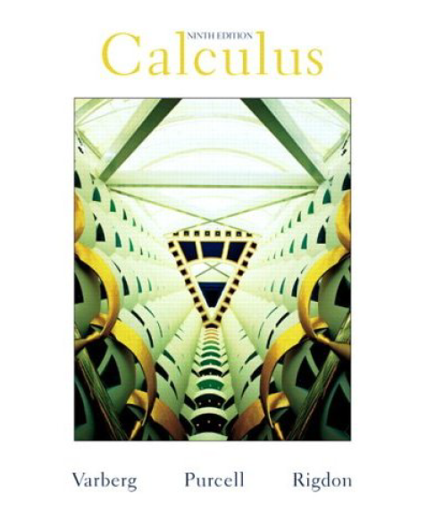
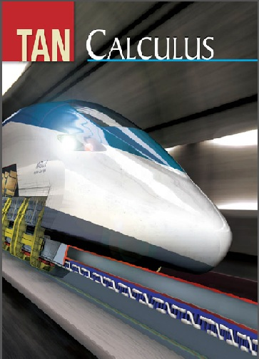
These slides have been adapted from: Dale Varberg, Edwin Purcell, Steve Rigdon. 2007. Calculus. Prentice Hall. ISBN: 978-0132306331. Soo.T.Tan. Calculus. 2010. Brooks/Cole. ISBN-13: 978-0-534-46579-7
Acknowledgement

Slide 3

Learning Objectives
LO 3:
Explain the properties of integral to describe geometric and physical problems, and
other applications.

Slide 4
Content
1
Basic integration rules
2
Integration by parts
3
Rationalizing substitutions
4
Integration of rational functions using Partial Fractions

Slide 5
Basic Integration Rules

Slide 6


Integration by Parts
$$\text{Indefinite} \text{Integrals}$$
$$\int{udv}=uv−\int{vdu}$$
Definite Integrals
$$\int_{a}^{b}{udv}={\left[uv\right]}_{a}^{b}−\int_{a}^{b}{vdu}$$

Slide 7
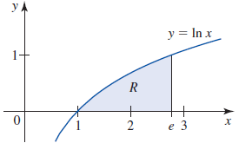
Example 1
The area of the region under the
graph of f(x) = ln x on [1,e] is
shown in Figure.
The area of R is given by
Let u = ln x and dv = dx, then du = dx/x and v = x: So that,

Slide 8
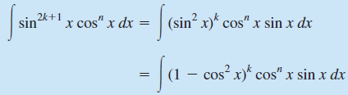
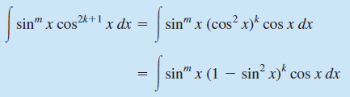
Integrals of the Form
∫sin^{m}x cos^{n}x dx
1
2

Slide 9
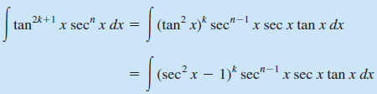
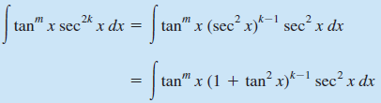
Integrals of the Form
∫tan^{m}x sec^{n}x dx
1
2

Slide 10
Example 2 (1/2)
Find ∫sin⁵x cos²x dx.
Solution
Here m (the power of sin x) is an odd positive integer.
Let’s write
Then

Slide 11
Example 2 (2/2)
Make the substitution u = cos x, then du = -sin x dx, so

Slide 12
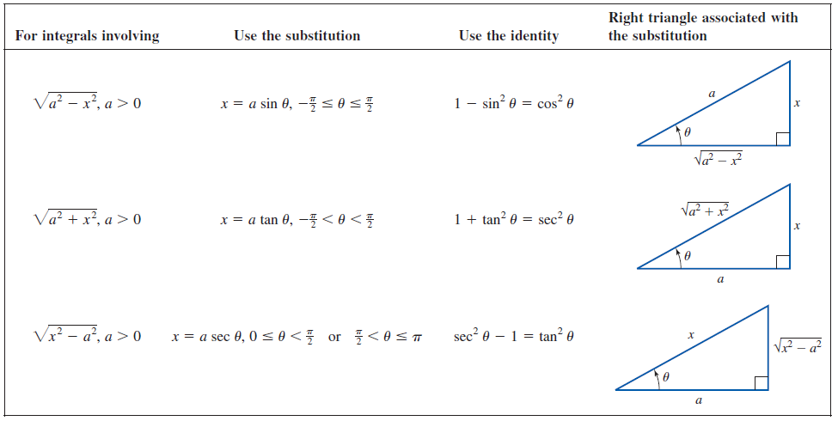
Rationalizing Substitutions

Slide 13
Example 3 (1/2)
1st step
2nd step
Let , then the
integrand involves a radical
of the form
where a = 3.
Use the trigonometric
substitution
x = 3 sinθ
so that dx = 3 cos θ dθ
where –π/2 < θ < π/2.

Slide 14
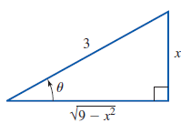
Example 3 (2/2)
Observe that sinθ = x/3 implies that θ = sin⁻¹(x/3). Next, observe that sin2θ = 2 sinθcosθ.
With the help of Figure, we find
Therefore,

Slide 15
Partial Fractions: Case 1

Slide 16
Example 6 (1/2)
Find .
Solution
Since the degree of the numerator of the integrand is greater than that of the denominator, we use long division to write
Next, we decompose (8x - 3)/(2x² + x – 3) into a sum of partial fractions.

Slide 17
Example 6 (2/2)
Therefore
Multiplying through by (2x + 3)(x - 1) gives
8x – 3 = A(x - 1) + B(2x + 3)
So that B = 1 and A = 6. Therefore,

Slide 18
Partial Fractions: Case 2
Repeated Linear Factors:
Q(x) contains a factor (ax + b)^{r} with r > 1
The partial fraction decomposition of R(x)/Q(x) contains a sum of partial fractions of the form
Where each A_{k} is a real number

Slide 19
Example 7 (1/2)
Find
Solution
Note that
Since -1 is a zero of multiplicity 2, the partial fraction decomposition of the integrand has the form
Multiplying both sides of this equation by (x+1)²(x-1), we obtain

Slide 20
Example 7 (2/2)
Finally, we get A = -1, B = -3, and C = 3.
Therefore,

Slide 21
Partial Fractions: Case 3

Slide 22
Example 8 (1/3)
Find
Solution
Since the degree of the numerator is not less than the degree of the denominator, we use long division to write
Notice that x² + 2x + 5 is irreducible so that

Slide 23
Example 8 (2/3)
Equating the coefficients of like powers of x yields the system
A + C = 1
2A + B + D = 5
5A + 2B + 4C = 6
5B + 4D = 21
The solution of the system is A = 0, B = C = 1, and D = 4.
Therefore

Slide 24
Example 8 (3/3)
To evaluate the integral on the right, we complete the square in the denominator of the integrand.
So,

Slide 25
Partial Fractions: Case 4
Repeated Irreducible Quadratic Factors:
Q(x) contains a factor (ax² + bx + c)^{r} with r > 1, where ax² + bx + c is irreducible
The partial fraction decomposition of R(x)/Q(x) contains a sum of partial fractions of r partial fractions of the form
Where each A_{k} and B_{k} are real number

Slide 26
Dale Varberg, Edwin Purcell, Steve Rigdon. 2007. Calculus. Prentice Hall. ISBN: 978-0132306331.
Dale Varberg, Edwin Purcell, Steve Rigdon. 2014. Calculus Early Transcendentals. Pearson New International Edition. ISBN: 978-1-292-04268-8
Soo.T.Tan. 2010. Calculus. Brooks/Cole. ISBN-13: 978-0-534-46579-7

